Slide 1


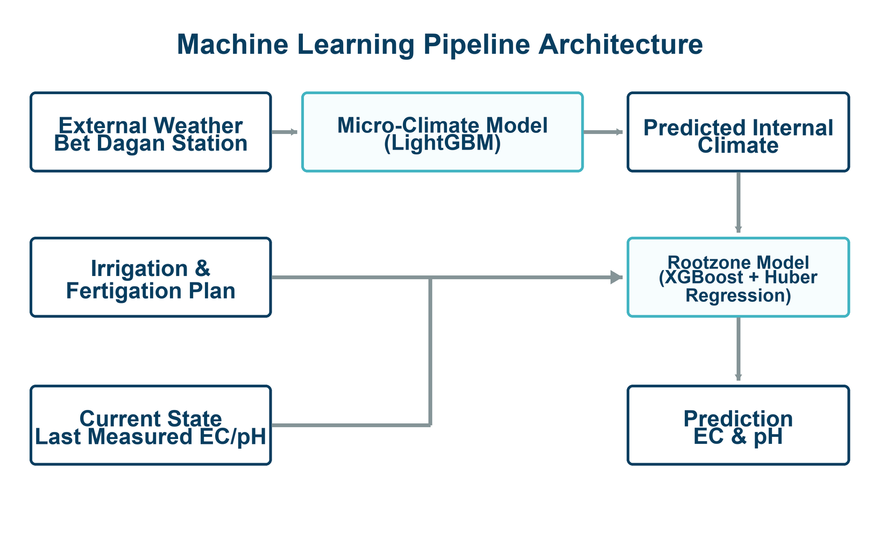
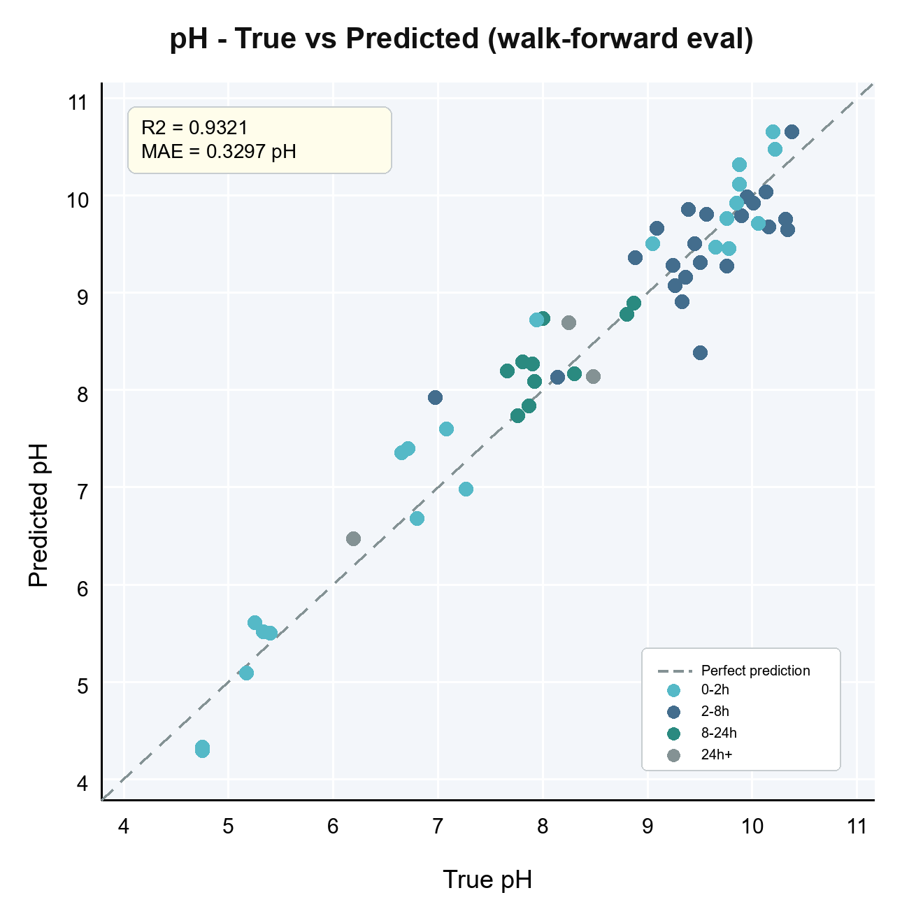
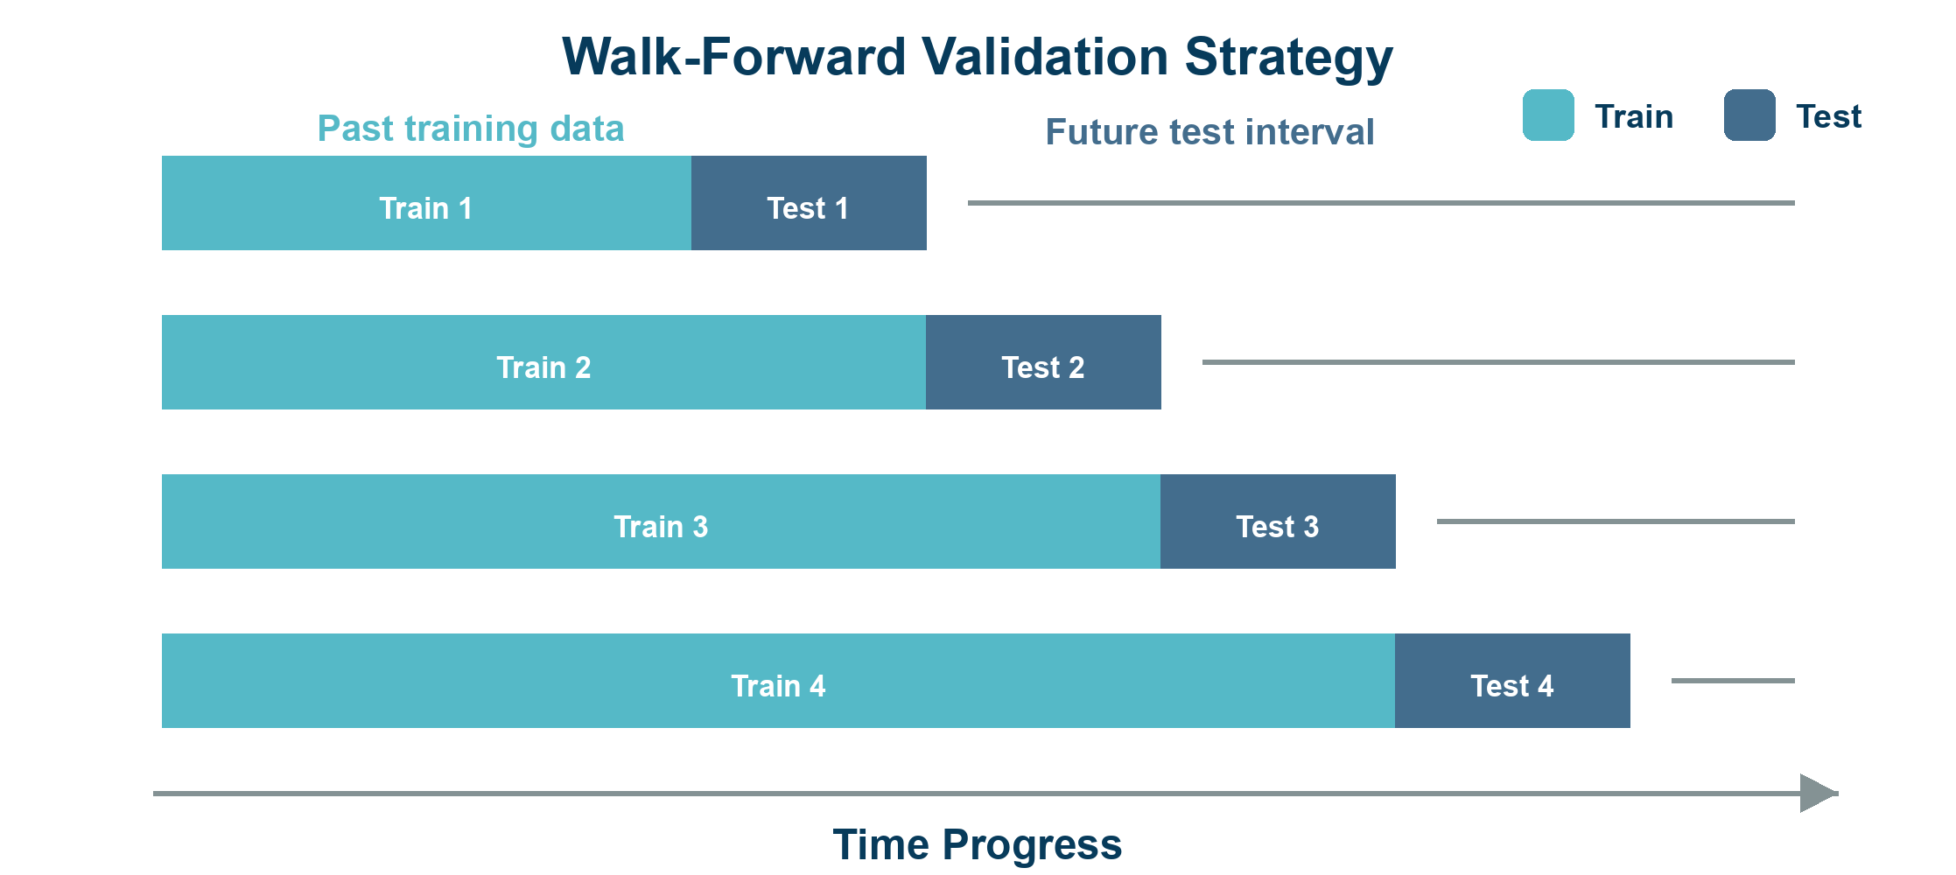
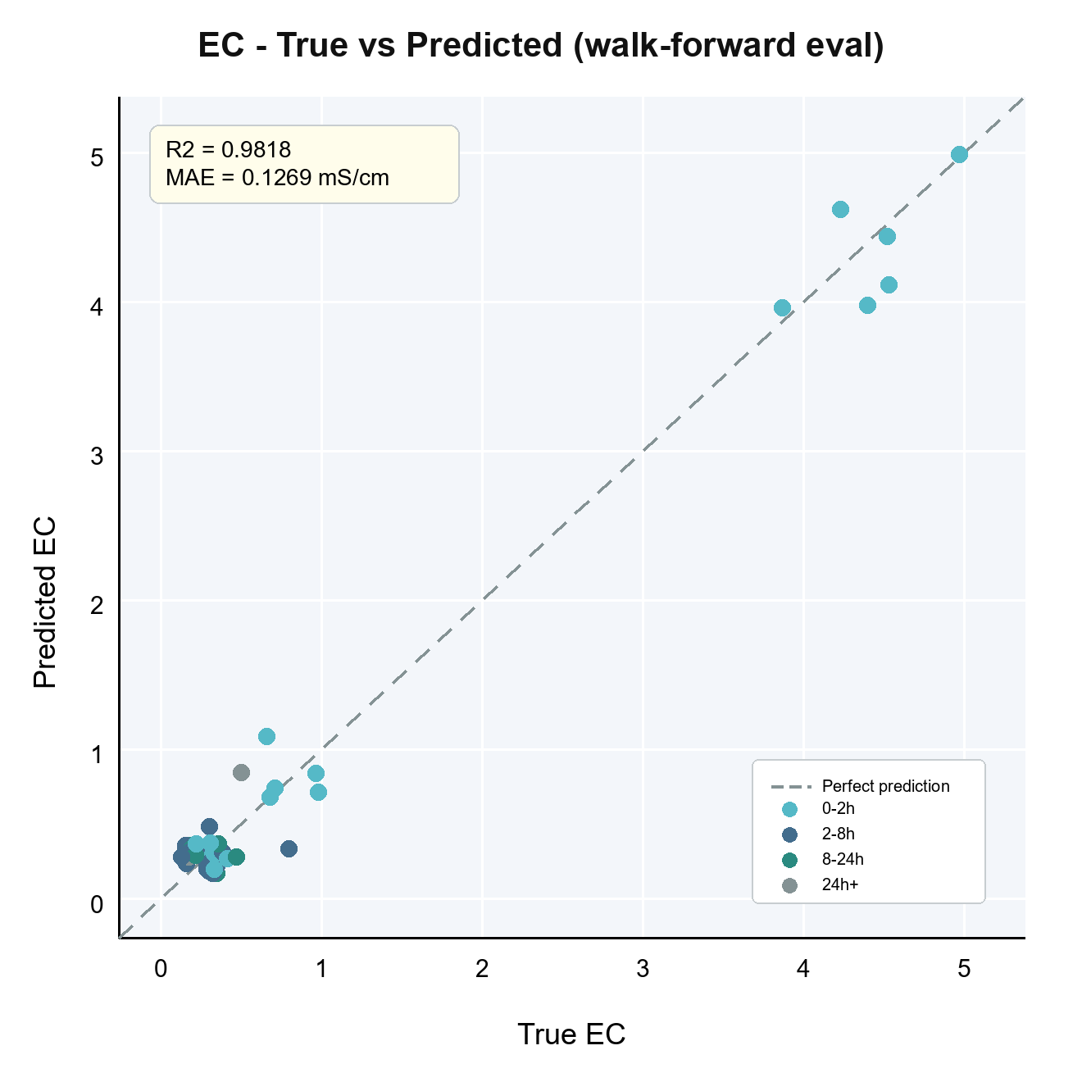
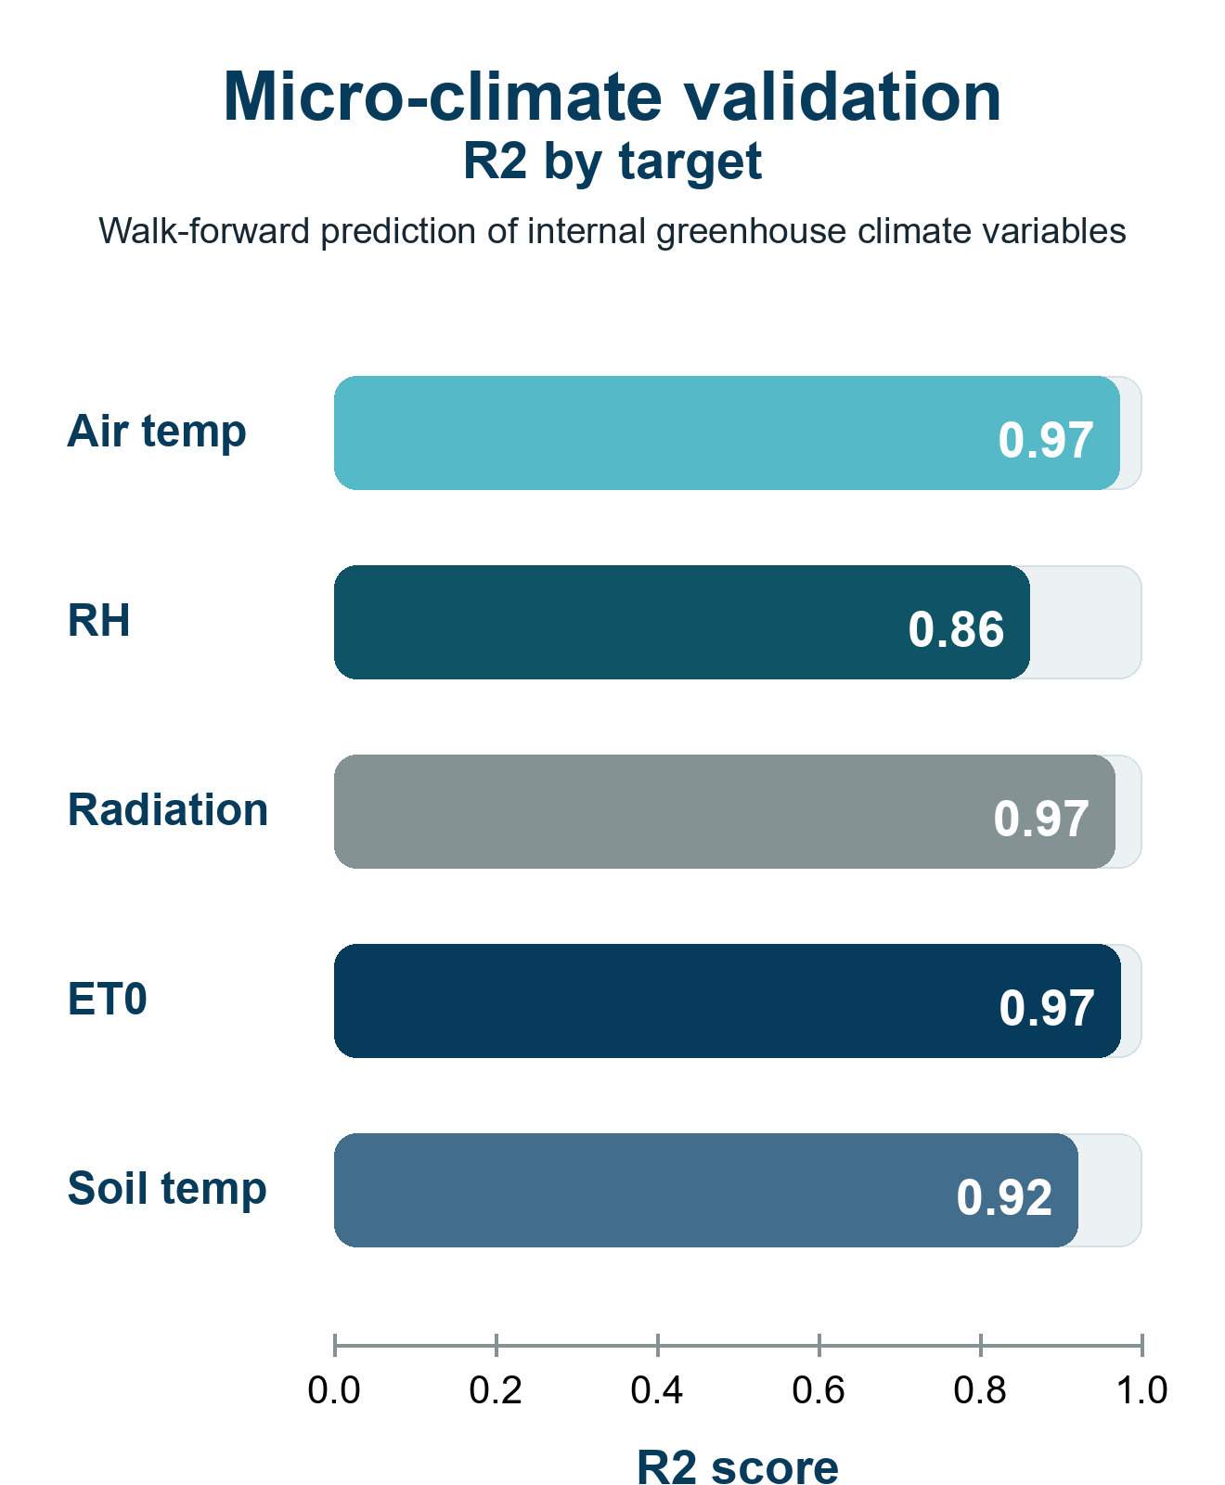
Ruppin Academic Center | Department of Computer Science
Artificial Intelligence and Data Science Specialization
Predictive Modeling of Root-Zone Variables Using Greenhouse Data
Students: Eden Eliyahu, Oren Chaushu
Mentors: Dr. Avner Priel, Dr. Alaa Jamal
01
Motivation
05
Method
08
Key Results
Root-zone pH controls nutrient availability; EC reflects salinity and fertilizer concentration.
Manual lab measurements are reliable, but sparse and reactive.
Continuous sensors can drift, need calibration, and may not represent the whole root zone.
Stage 1: LightGBM predicts greenhouse micro-climate from external weather and radiation.
Stage 2: XGBoost and Huber regression predict future root-zone pH and EC from anchor measurements.
The model learns interval change from t0 to t1 instead of treating every timestamp as a label.
0.33
62%
0.932
pH MAE
pH gain
pH R2
0.127
35%
0.982
02
Project Goal
EC MAE
EC gain
EC R2
Develop a machine-learning soft sensor that predicts root-zone pH and EC to support timely irrigation and fertigation decisions, maintain optimal root-zone conditions, and prevent salinity or pH imbalance.
03
Data
16,682
109
20
06
Validation Strategy
10-minute
rows
pH/EC
labels
input
features
Walk-forward validation: train only on past observations and predict future samples.
Skipped-interval holdout: remove selected target intervals from training and predict them later.
Metrics are interpreted per target: pH and EC mS/cm
Unified 10-minute Master Dataset, May 29-Sep 21, 2025.
Dense inputs combine weather, greenhouse climate, fertigation, crop state, and time history.
Sparse manual pH/EC samples are used as target labels.
Climate conditions
temperature - humidity - radiation
Irrigation & fertigation
water - fertilizer - acid - salts
Plant status
canopy cover - crop age
07
Micro-Climate Model
Root-zone measurements
Estimates internal greenhouse climate from external weather and radiation.
Creates continuous climate features for the root-zone prediction model.
Helps the pH/EC model account for plant stress, evaporation, and irrigation demand between sparse lab samples.
manual pH & EC samples
Time & history
timestamps - gaps - previous state
04
Algorithms & Model Choice
Gradient Boosting
Captures nonlinear interactions in tabular greenhouse data.
09
Conclusions
LightGBM
Soft-sensor forecasts root-zone pH and EC between sparse lab samples.
Two-stage pipeline combines weather, micro-climate, fertigation, crop state, and previous pH/EC.
Improved over last-measurement baseline: +62% pH, +35% EC.
Supports earlier fertigation decisions; not autonomous control.
Predicts internal micro-climate from external weather.
XGBoost
Predicts root-zone pH/EC from sparse labels and engineered features.
10
Challenges & Limitations
109 pH/EC labels vs 16,682 dense records.
No continuous root-zone ground truth between lab samples.
Irregular intervals required t0-to-t1 modeling.
Low EC: small absolute errors become large relative errors.
One season only; more crops and seasons needed.
Huber Regression
Stabilizes predictions under sharp fertigation, acid, or salinity shifts.

